Slide 1
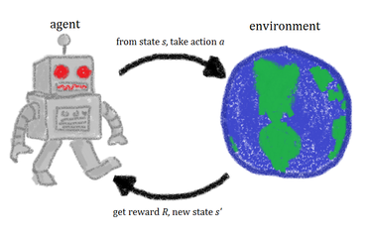
https://www.cs.cmu.edu/~avrim/ML14/lect0326.pdf

Slide 2
https://www.cs.cmu.edu/~avrim/ML14/lect0326.pdf
http://teaching.csse.uwa.edu.au/units/CITS4211/Lectures/wk7.pdf
probabilistic-numerics.org/assets/pdf/NIPS2016/talks/SammyHansen.pptx

Slide 3
Machine learning Type:
There are three broad types of learning:-
1 Supervised learning (learning with a teacher)
2 Reinforcement learning (learning with limited feedback)
3 Unsupervised learning (learning with no help)

Slide 4
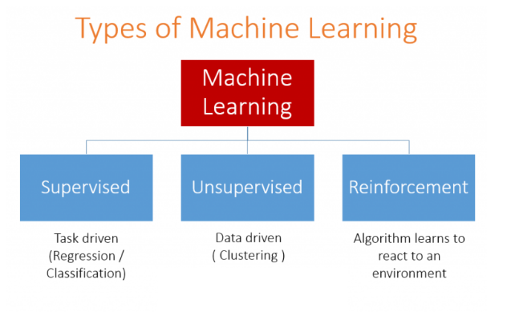

Slide 5
Supervised vs Reinforcement Learning: In supervised learning, there’s an external “supervisor”, which has knowledge of the environment and who shares it with the agent to complete the task. But there are some problems in which there are so many combinations of subtasks that the agent can perform to achieve the objective. So that creating a “supervisor” is almost impractical. For example, in a chess game, there are tens of thousands of moves that can be played. So creating a knowledge base that can be played is a tedious task. In these problems, it is more feasible to learn from one’s own experiences and gain knowledge from them. This is the main difference that can be said of reinforcement learning and supervised learning. In both supervised and reinforcement learning, there is a mapping between input and output. But in reinforcement learning, there is a reward function which acts as a feedback to the agent as opposed to supervised learning.
Unsupervised vs Reinforcement Leanring: In reinforcement learning, there’s a mapping from input to output which is not present in unsupervised learning. In unsupervised learning, the main task is to find the underlying patterns rather than the mapping. For example, if the task is to suggest a news article to a user, an unsupervised learning algorithm will look at similar articles which the person has previously read and suggest anyone from them. Whereas a reinforcement learning algorithm will get constant feedback from the user by suggesting few news articles and then build a “knowledge graph” of which articles will the person like.

Slide 6
Reinforcement Learning:
A system interacts with a dynamic environment in which it must perform a certain goal (such as driving a vehicle or playing a game against an opponent).
The system is provided feedback in terms of rewards and punishments as it navigates its problem space.

Slide 7
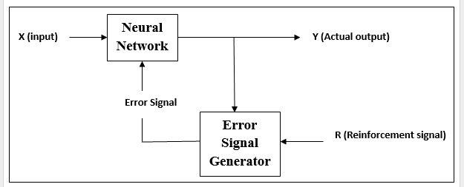

Slide 8
Reinforcement Learning
As the name suggests, this type of learning is used to reinforce or strengthen the network over some critic information.
During the training of network under reinforcement learning, the network receives some feedback from the environment. This learning process is similar to supervised learning, however we might have very less information.
This makes it somewhat similar to supervised learning.
After receiving the feedback, the network performs adjustments of the weights to get better critic information in future.

Slide 9
History of Reinforcement
The term reinforcement was introduced by Pavlov in 1903 to describe the strengthening of the association between an unconditioned and a conditioned stimulus that results when the two are presented together.
If the association is not periodically "reinforced" by such pairing, the effectiveness of the conditioned stimulus decays: the conditioned response undergoes extinction.
For Pavlov, any unconditioned stimulus, such as food or a puff of air to the eye, was a potential reinforcer; the pairing of such a stimulus with a neutral stimulus constituted reinforcement.

Slide 10
Edward Thorndike first introduced the concept of Response Reinforcement
The concept of reinforcement means getting the work completed by giving some incentives or rewards

Slide 11
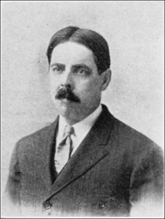
Edward Thorndike had a powerful impact on
Reinforcement theory and behavior analysis,
providing the basic framework for empirical laws in behavior psychology
Edward Lee Thorndike (August 31, 1874 – August 9, 1949) was an American psychologist who spent nearly his entire career at Teachers College, Columbia University

Slide 12
Meaning of Reinforcement
The term reinforcement means to strengthen, and is used in psychology to refer to anything stimulus which strengthens encouraging the designated behavior or increases the probability of a specific response.
Example: if you want your dog to sit on command, you may give him a treat every time he sits for you.
The dog will eventually come to understand that sitting when told to will result in a treat.
This treat is reinforcing because he likes it and will result him sitting when instructed to do so.

Slide 13
Reinforcement Learning
Learning from interaction
Goal-oriented learning
Learning about, from, and while interacting with an external environment
Learning what to do—how to map situations to actions—so as to maximize a numerical reward signal
Example: Bicycle learning

Slide 14
Reinforcement Learning (RL) is learning through direct experimentation.
It does not assume the existence of a teacher that provides ‘training examples’ upon which learning of a task takes place
Instead, in RL experience is the only teacher
The learning environment is composed of:
Learning agent (or simply the learner)
2. A dynamic process.
At successive time steps, the agent makes an observation of the process state, selects an action and applies it back to the process, modifying the state.

Slide 15
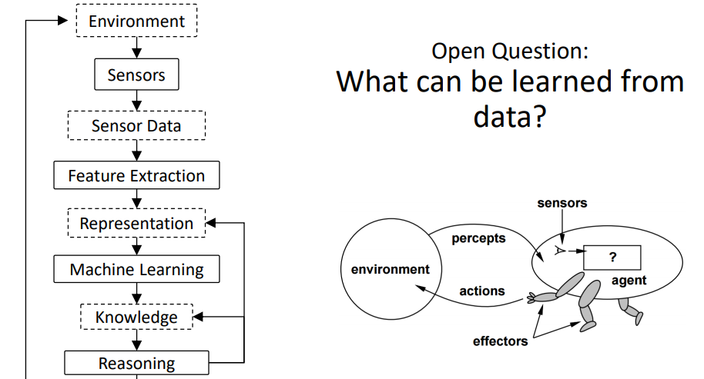
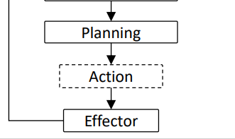

Slide 16
file:///C:/UTUBE%20DOWNLOADS/MidSemPresentation_FDTS_F421T_SagnikMajumder_2014A8TS0464P.pdf

Slide 17
Examples of application of RL
Robotics: Quadruped Gait Control, Ball Acquisition (Robocup)
Operations Research: Pricing, Routing, Scheduling
Game Playing: Backgammon, Solitaire, Chess, Checkers, Go
Human Computer Interaction: Spoken Dialogue Systems
Economics/Finance: Trading

Slide 18
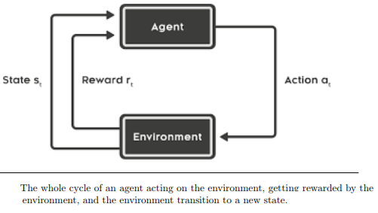

Slide 19
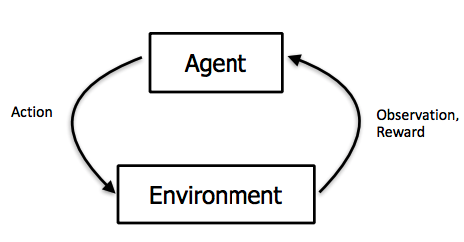

Slide 20
The five primary key words of RL :
• Agent
plays the central role in an RL algorithm problem.
It is both the doer i.e. takes actions according to a learned policy, and the receiver i.e. the recipient of rewards upon taking actions.
• Environment
the ambience or the surroundings in which the agent acts and gets rewarded.
• State
different settings that the environment can be in at a particular instant in time
• Action
The actions are the different possibilities of acting that an agent has when it is in a particular state in the environment
• Reward
.
.

Slide 21
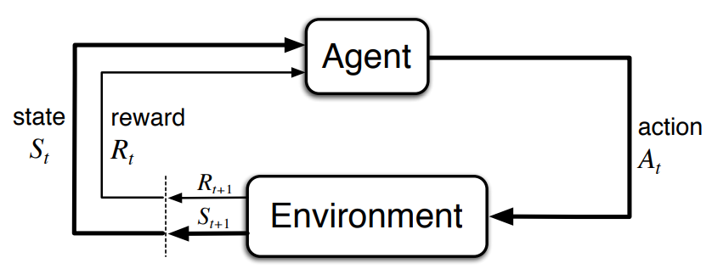
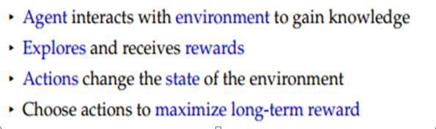
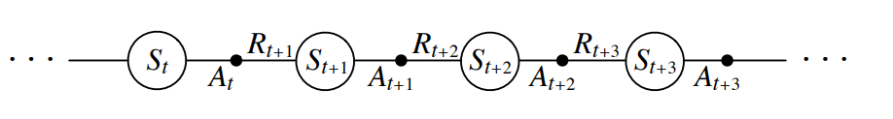

Slide 22
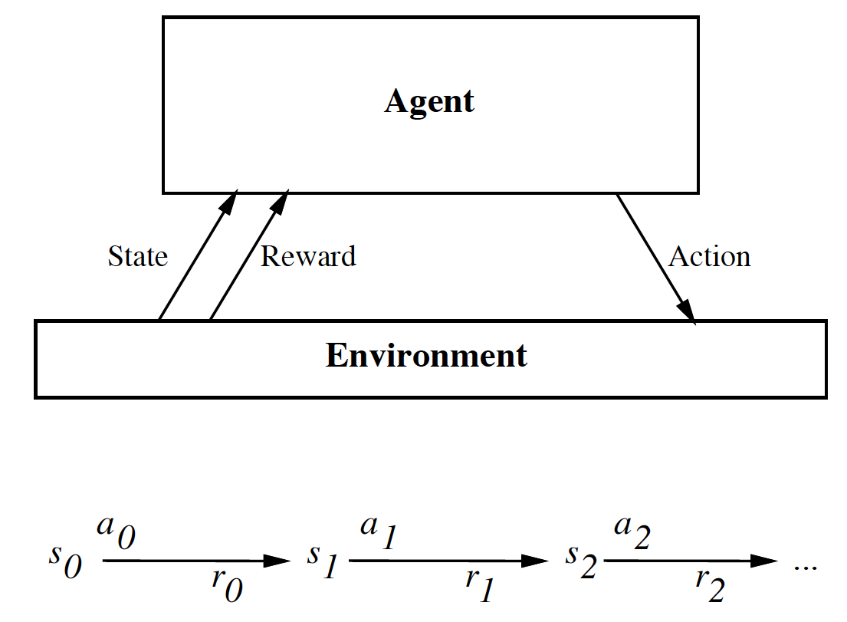
We treat this history of interaction as a sequence of experiences, where an experience is a tuple
⟨s,a,r,s'⟩,
which means that the agent was in state s, it did action a, it received reward r, and it went into state s'. These experiences will be the data from which the agent can learn what to do. As in decision-theoretic planning, the aim is for the agent to maximize its value,

Slide 23
We treat this history of interaction as a sequence of experiences, where an experience is a tuple
⟨s,a,r,s'⟩,
which means that the agent was in state s, it did action a, it received reward r, and it went into state s'. These experiences will be the data from which the agent can learn what to do. As in decision-theoretic planning, the aim is for the agent to maximize its value,

Slide 24
At successive time steps, the agent makes an observation of the process state, selects an action and applies it back to the process, modifying the state.
The goal of the agent is to find out adequate actions for controlling this process.
In order to do that in an autonomous way, it uses a technique known as Reinforcement Learning

Slide 25
The ultimate goal of an RL agent is to maximize the total reward at the end of its action sequence.
Thus, it attempts to take such a sequence of actions which will help it in realizing this goal.
Hence, the objective of an RL algorithm is to efficiently generate a policy after sufficient learning/trial time that will produce trajectories or sequence of actions which maximize the total end reward.

Slide 26
The ultimate goal of an RL agent is to maximize the total reward at the end of its action sequence.
Thus, it attempts to take such a sequence of actions which will help it in realizing this goal.
Hence, the objective of an RL algorithm is to efficiently generate a policy after sufficient learning/trial time that will produce trajectories or sequence of actions which maximize the total end reward.
The RL algorithm essentially trains a controller to do this over multiple runs of trial/training. Figure 3.2 is an example RL problem. In this example, the goal is to find the shortest path from the start to the end of the maze. The reward value is −1 for each step taken. Therefore, the RL controller gets trained to produce a policy that generates the shortest path (the most optimal trajectory) from any state. The maze on the right graphically represents the most optimal trajectories from all possible stat

Slide 27
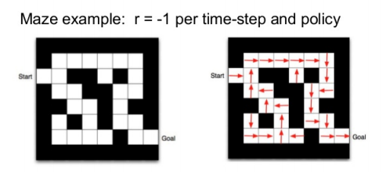
Left: A maze with a start and a goal is the environment, the RL problem is such that a reward of −1 is awarded per time step and hence, and the goal is to find the optimal path/trajectory to the goal of the maze from every possible position/state in the maze. Right: The optimal paths/trajectories corresponding to a trained policy, from every position/state.
file:///C:/UTUBE%20DOWNLOADS/MidSemReport_FDTS_F421T_SagnikMajumder_2014A8TS0464P.pdf

Slide 28
The state of the environment at time t is denoted by st , the action taken by the agent at time t is given by rt , and the reward at time t is r(st , at). The state might not be always same as the way it is observed by the agent due to some sort of obstruction or occlusion, and the observation at time t is represented by ot . If the state is exactly as observed, then the setting is a fully-observed setting or else it’s a partially-observed setting. The policy in a fully-observed setting is given by π θ (a_{t} |s_{t} ) while in a partially-observed setting, it’s given by π θ (a_{t} |o_{t} ). The parameters θ are the RL controller parameters which are tuned during the training of the controller by running RL algorithm such that at the end, the controller generates the most optimal trajectories. The parameters θ might be the parameters of a neural network based RL controller as shown in figure 3.3. Figure 3.3 also shows the basic RL loop. Besides, any RL setting can be thought of as a a Markov decision process (MDP) in which the Markov property is maintained because the state-transition probabilities, which give the chances of going to a particular state from a given state after taking a given action, are functions of the present state and the present action o

Slide 29
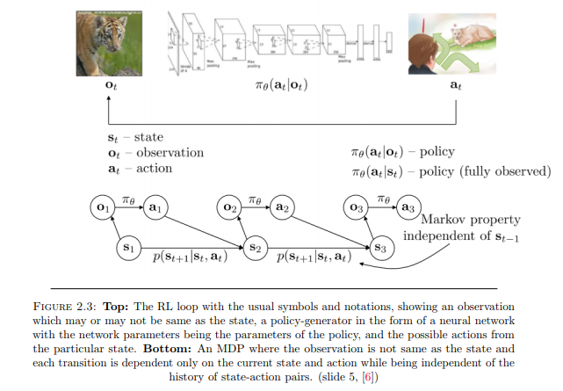

Slide 30
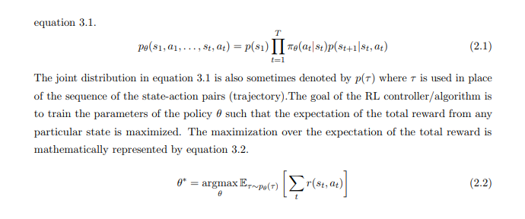

Slide 31
Reinforcement Machine Learning In Reinforcement Machine Learning, trial and error is used by an algorithm to determine which action yields the highest reward. Reinforcement Machine Learning is predicated on 3 main components: 1) an agent who is the primary decision maker, 2) the environment which constitutes everything the agent interacts with and 3) actions which dictate what the agent does. The intent of Reinforcement Machine Learning is for the agent to perform actions that lead to maximum reward or drive the most optimal outcome. Reinforcement Machine Learning is often utilized in gaming and robotics. Optimization techniques are commonly used in Reinforcement Machine Learning
Reinforcement Learning: A system interacts with a dynamic environment in which it must perform a certain goal (such as driving a vehicle or playing a game against an opponent). The system is provided feedback in terms of rewards and punishments as it navigates its problem space.
Between supervised and unsupervised learning is semi-supervised learning, where the teacher gives an incomplete training signal: a training set with some (often many) of the target outputs missing. We will focus on unsupervised learning and data clustering in this blog post.

Slide 32

Outline
Introduction
Elements of Reinforcement learning
Complications of Reinforcement Learning
Types of Reinforcement Learning
Q learning
Markov property

Slide 33
Outline
Introduction
Elements of Reinforcement learning
Complications of Reinforcement Learning
Types of Reinforcement Learning
Q learning

Slide 34
Introduction
Machine learning:
Machine learning is a scientific discipline that is concerned with the design and development of algorithms that allow computers to learn based on data, such as from sensor data or databases.
A major focus of machine learning research is to automatically learn to recognize complex patterns and make intelligent decisions based on data .

Slide 35

MOTIVATION

Slide 36
Machine learning Type:
There are three broad types of learning:-
1 Supervised
2 Reinforcement learning
3 Unsupervised learning

Slide 37
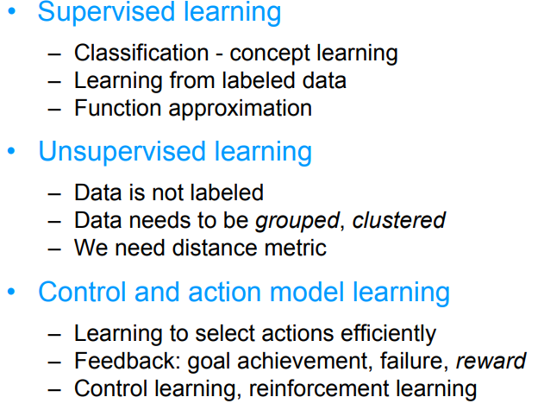
http://www.cs.cmu.edu/afs/andrew/course/15/381-f08/www/lectures/HandoutMDP.pdf

Slide 38
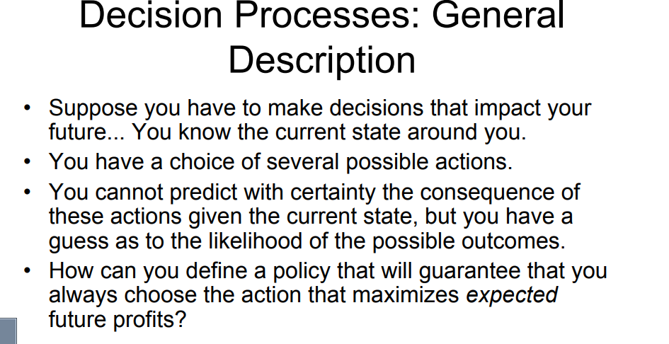
Artificial Intelligence: A Modern Approach
(Third edition) by Stuart Russell and Peter Norvig

Slide 39
Markov decision processes (MDP) formally describe an environment for reinforcement learning
Where the environment is fully observable i.e.
The current state completely characterizes the process
“The future is independent of the past given the present”
A state should summarize past sensations so as to retain all “essential” information, i.e., it should have the Markov Property

Slide 41
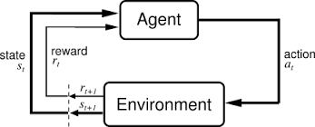
Reinforcement Learning Framework

Slide 42
what does Markov mean?
The term “Markov” in “Markov Decision Processes” means that the outcome of an action depends only on the current state and the action taken.
We do not need the list of previous actions and states to determine the immediate next state in the future.
So in MPD’s the present state, action pair holds all the information required for determining resulting future state

Slide 43
Markov Decision Processes (MDP’s)
An MDP is fully characterized by the following 5 elements
A set of States s ∈ S
A set of Actions a ∈ A
A Transition Function T(s, a, s’)
A Reward Function R(s, a, s’)
Discount Factor (γ)
Any problem for which these 5 elements are defined is an MDP problem.

Slide 44
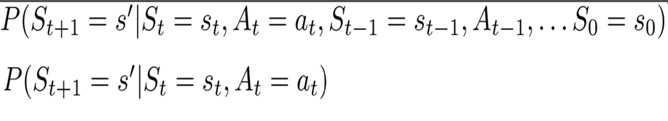
what does Markov mean?

Slide 45
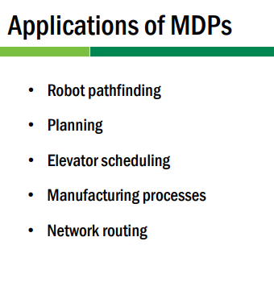

Slide 46
Supervised Learning
Training Info = desired (target) outputs
Supervised Learning
System
Inputs
Outputs

Slide 47
Reinforcement Learning
Training Info = evaluations (“rewards” / “penalties”)
RL
System
Inputs
Outputs (“actions”)
Objective: get as much reward as possible

Slide 48
Reinforcement Learning in a nutshell
RL is a general-purpose framework for decision-making
RL is for an agent with the capacity to act
Each action influences the agent’s future state
Success is measured by a scalar reward signal
Goal: select actions to maximise future reward
Rewards specify what the agent needs to achieve, not how to achieve it

Slide 49
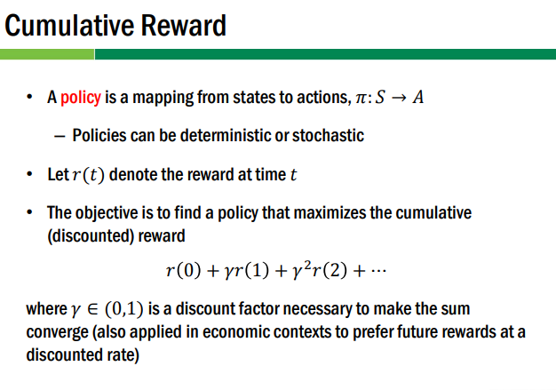

Slide 50
Model-free and Model-based Learning
Model-based learning ( Indirect method)
Learn from the model instead of interacting with the world
Model-free learning(Direct method)
Sample Reward and transition function by interacting with the world

Slide 51
Model-free and Model-based Learning
Model-based learning
Learn from the model instead of interacting with the world
Can visit arbitrary parts of the model
Also called indirect methods
E.g. Dynamic Programming
Model-free learning
Sample Reward and transition function by interacting with the world
Also called direct methods

Slide 52
Passive vs Active Types of RL
Passive: Agent executes a fixed policy and evaluates it
Active: Agents updates policy as it learns

Slide 53
Exploitation vs Exploration
A fundamental issue in reinforcement learning algorithms is the balance between exploration of the environment and exploitation of information already obtained by the agent.
Taking the action which the agent estimates to be the best at the current moment is an example of exploitation(greedy approach): the agent is exploiting its current knowledge about the reward structure of the environment to act.
The opposite approach to greedy selection is to simply always take a random action- exploration.

Slide 54
Exploitation vs Exploration
Exploitation : make the best decision given current information
Exploration : Gather more information
The best long-term strategy may involve short term sacrifices
Gather enough information to make the best overall decisions.

Slide 55
Exploitation Vs Exploration (Contd.)
Pure Exploitation
Mostly gets stuck in bad policies
Pure Exploration
Gets better models by learning
Small rewards due to exploration

Slide 56
Trade-off
Exploitation: Maximize rewards using current estimates. Agent stops learning and starts executing policy
Exploration: Maximize long term rewards Agent keeps learning by trying out new things

Slide 57
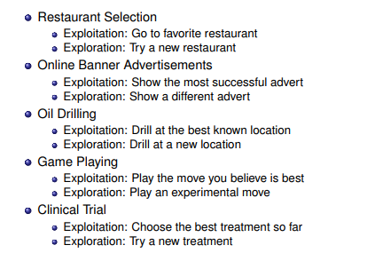

Slide 58
EXPLORATION/EXPLOITATION TRADEOFF One simple strategy for exploration would be :
to take the best known action most of the time (say, 80% of the time), but occasionally explore a new, randomly selected direction even though it might be walking away from known reward.
This strategy is called the epsilon-greedy strategy, where epsilon is the percent of the time that the agent takes a randomly selected action rather than taking the action that is most likely to maximize reward given what it knows so far (in this case, 20%).
We usually start with a lot of exploration (i.e. a higher value for epsilon).
Over time, it would make sense to steadily reduce epsilon to 10% or even lower as it settles into exploiting what it knows.

Slide 59
Elements of Reinforcement Learning
Agent
Policy
state
Reward
Action
Environment
Agent: Intelligent programs
Environment: External condition
Policy:
Defines the agent’s behavior at a given time
A mapping from states to actions
Lookup tables or simple function

Slide 60
Elements of Reinforcement Learning
Policy: what to do
Reward: what is good
Value: what is good because it predicts reward
Model: what follows what

Slide 61
Elements of Reinforcement Learning
Policy
Reward
Value
Model of
environment
Policy: what to do
Reward: what is good
Value: what is good because it predicts reward
Model: what follows what

Slide 62
Elements of Reinforcement Learning
Reward function :
Defines the goal in an RL problem
Policy is altered to achieve this goal
Value function:
Reward function indicates what is good in an immediate sense while a value function specifies what is good in the long run.
Value of a state is the total amount of reward an agent can expect to accumulate over the future, starting form that state.
Model of the environment :
Predict mimic behavior of environment
Used for planning & if Know current state and action then predict the resultant next state and next reward.

Slide 63
Complications
The outcome of your actions may be uncertain
You may not be able to perfectly sense the state of the world
Reward is delayed (i.e. finding food in a maze)
You may have no clue (model) about how the world responds to your actions.
You may have no clue (model) of how rewards are being paid off.
The world may change while you try to learn it
How much time do you need to explore uncharted territory before you exploit what you have learned?

Slide 64
The Big Picture
S: state
a : action

Slide 65
The Big Picture
S: state
a : action
Your action influences the state of the world which determines its reward

Slide 66
The Markov Property
Environment's response at (t+1) depends only on State (s) & next state (S’) & Action (a) at t,
We made simplifying assumptions: e.g. state of the world only depends on last state and action. This is the Markov assumption. The model is called a Markov Decision Process (MDP).

Slide 67
Markov Decision Processes
If a reinforcement learning task has the Markov Property, it is basically a Markov Decision Process (MDP).
If state and action sets are finite, it is a finite MDP.
To define a finite MDP, you need to give:
state and action sets
transition probabilities
reward probabilities

Slide 68
MDP Vs RL
MDP Vs RL
Markov decision process
Set of states S, set of actions A
Transition probabilities to next states T(s, a, a’)
Reward functions R(s)
RL is based on MDPs, but
Transition model is not known
Reward model is not known
MDP computes an optimal policy
RL learns an optimal policy

Slide 69
Key Features of RL
Learner is not told which actions to take
Trial-and-Error search
Possibility of delayed reward (sacrifice short-term gains for greater long-term gains)
The need to explore and exploit
Considers the whole problem of a goal-directed agent interacting with an uncertain environment

Slide 70
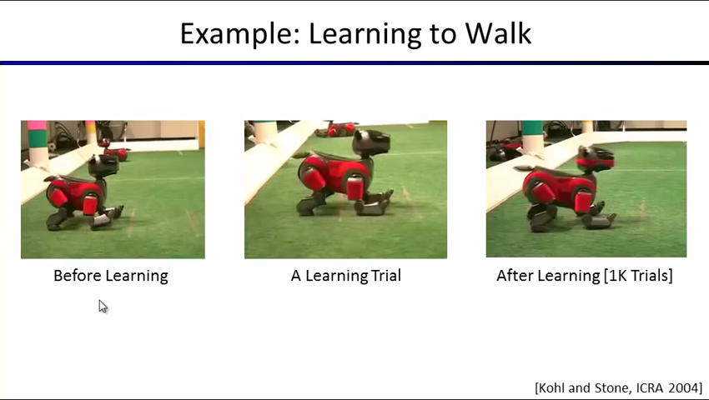

Slide 71
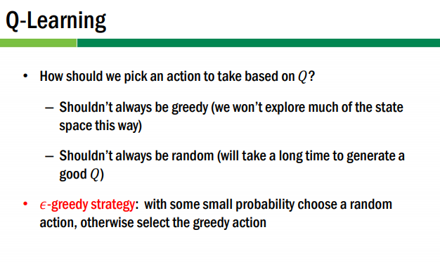
http://www.utdallas.edu/~nrr150130/cs6375/2015fa/lects/Lecture_25_RL.pdf

Slide 72
Q-learning: learning the action-value function
Q-learning is a model-free reinforcement learning technique. It is able to compare the expected utility of the available actions (for a given state) without requiring a model of the environment.
Deep Q-learning
An application of Q-learning to deep learning, by Google DeepMind, titled "deep reinforcement learning" or "deep Q-learning", was successful at playing Atari 2600 games at expert human levels.

Slide 73
Q-Learning
The central idea in Q-Learning is to recognize or learn the optimal action in every state visited by the system (also called the optimal policy) via trial and error.
The trial and error mechanism can be implemented within the real-world system (commonly seen in robotics) or within a simulator (commonly seen in management science / industrial engineering).

Slide 74
Trial and error mechanism of RL
Simulator
(environment)
Feedback
RL Algorithm
(Agent)
Action

Slide 75
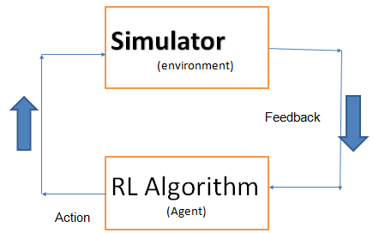
Trial and error mechanism of RL
The action selected by the RL agent is fed into the simulator. The simulator simulates the action, and the resultant feedback obtained is fed back into the knowledge-base (Q-factors) of the agent.
The agent uses the RL algorithm to update its knowledge-base, becomes smarter in the process, and then selects a better action.

Slide 76
Q-Learning: Working Mechanism
The agent chooses an action, obtains feedback for that action, and uses the feedback to update its database.
In its database, the agent keeps a so-called Q-factor for every state-action pair. When the feedback for selecting an action in a state is positive, the associated Q-factor’s value is increased, while if the feedback is negative, the value is decreased.
The feedback consists of the immediate revenue or reward plus the value of the next state.

Slide 77
Q-Learning: Feedback
The immediate reward is denoted by r(s, a, s’), where s is the current state, a the action chosen in the current state, and s’ the next state.
The value of any state is given by the maximum Q-factor in that state. Thus, if there are two actions in each state, the value of a state is the maximum of the two Q-factors for that state.

Slide 78
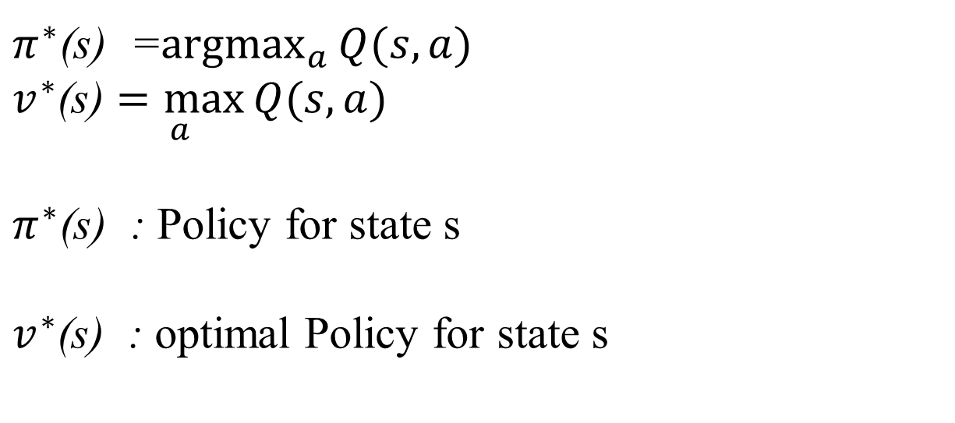
Q-Learning: Algorithm
Mathematically:
Q [s, a] = immediate reward +discounted reward
Q represents value of taking action ‘a’ in state ‘s’
$π^{∗}$(s) =$\underset{a}{argmax}{Q(s,a)}$
$v^{∗}$(s) $\underset{a}{=max}{Q(s,a)}$
$π^{∗}$(s) : Policy for state s
$v^{∗}$(s) : optimal Policy for state s
http://people.revoledu.com/kardi/tutorial/ReinforcementLearning/

Slide 79
http://www0.cs.ucl.ac.uk/staff/d.silver/web/Teaching_files/MDP.pdf

Slide 80
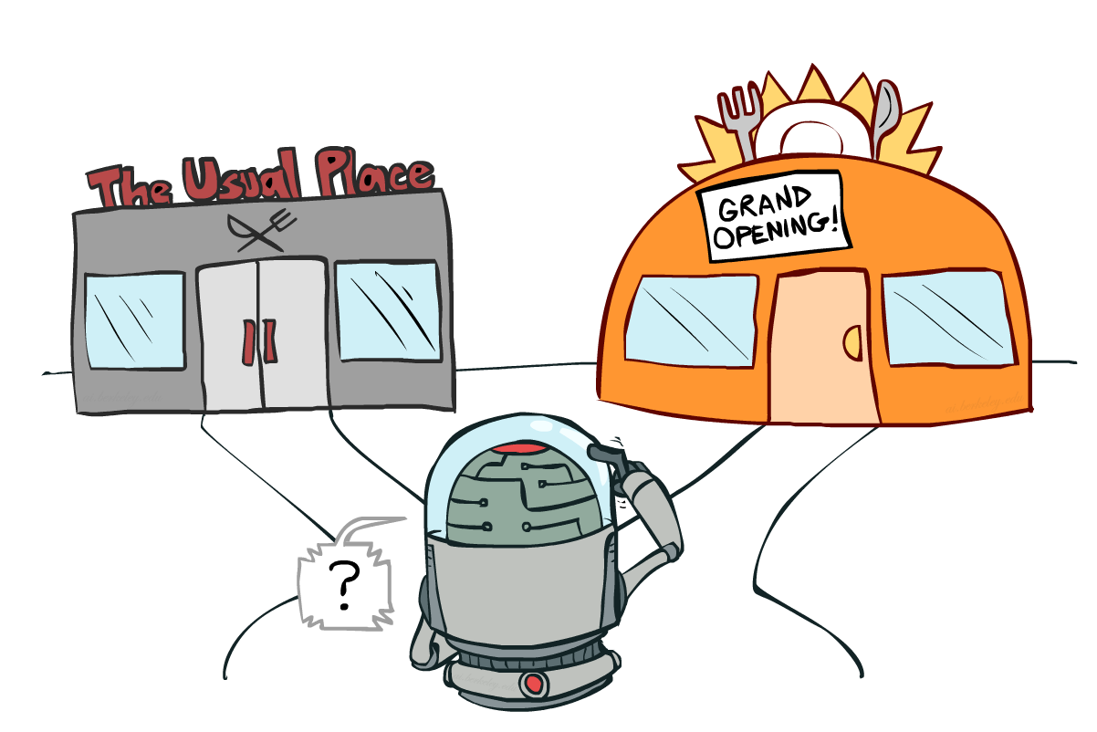
Exploration vs Exploitation
now in real scenarios when we do q-learning, there is always a trade-off
should we continue to perform random actions to know the q-values of each state better? (or)
should we use our knowledge of the q-values to start acting optimally
i.e, you know certain actions are good, but there are actions you haven’t tried out
so should you stop trying? but you may find something better
eventually we must stop exploring to act optimally,....but when do we stop?

Slide 81
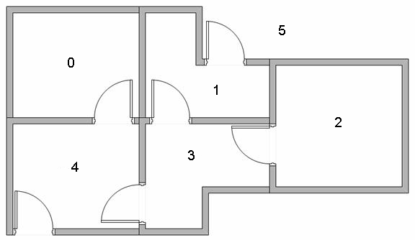
Q Learning Example
5 rooms in a building connected by doors
The outside of the building can be thought of as one big room (5).
Doors 1 and 4 lead from building to room 5 (outside).

Slide 82
http://mnemstudio.org/path-finding-q-learning-tutorial.htm

Slide 83
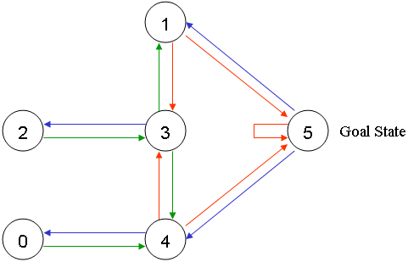
=>
Each room ≡ node
Each door ≡ link.
Goal room number =5
Room 5 loops back to itself .

Slide 84
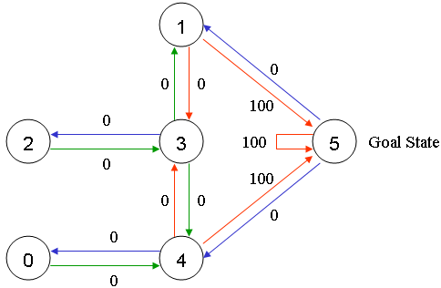
Each arrow contains an instant reward value,
associate a reward value to each door (i.e. link between nodes
The doors that lead immediately to the goal have an instant reward of 100
Otherwise reward = 0
In Q-learning, the goal is to reach the state with the highest reward, so that if the agent arrives at the goal, it will remain there forever. This type of goal is called an "absorbing goal".

Slide 85
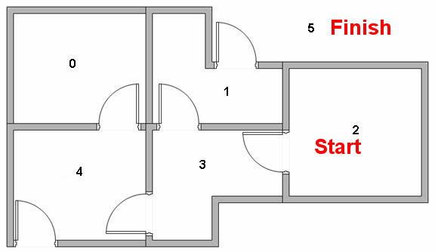
Imagine our agent as a dumb virtual robot that can learn through experience.
The agent can pass from one room to another but has no knowledge of the environment, and doesn't know which sequence of doors lead to the outside.

Slide 86
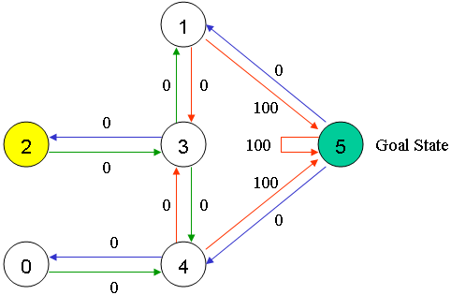
We'll call each room, including outside (room no 5), a "state“
The agent's movement from one room to another will be an "action"
In diagram, a "state" is depicted as a node, while "action" is represented by the arrows.

Slide 87
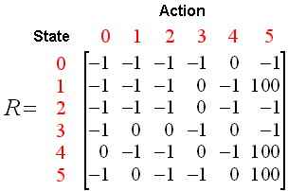
Reward Table, "matrix R".
-1 : No link between nodes
0 : reward is zero
100 : reward is 100 if reaching to goal state
MAKE Reward matrix

Slide 88
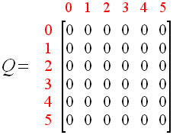
Matrix "Q"
Matrix, "Q“ : representing the memory of agent what the agent has learned through experience.
Rows : current state of the agent
Columns : possible actions leading to the next state (the links between the nodes).
matrix Q is initialized to zero as:

Slide 89
What We Have Till Now??
Reward Matrix (R)
Q Matrix (Q)

Slide 90
Q(state, action) = R(state, action) +
Gamma * Max[Q(next state, all actions)
According to this formula, a value assigned to a specific element of matrix Q, is equal to the sum of the corresponding value in matrix R and the learning parameter Gamma, multiplied by the maximum value of Q for all possible actions in the next state.
0 ≤ γ ≤ 1) closer to zero => the agent will tend to consider only immediate rewards
closer to one => the agent will consider future rewards with greater weight, willing to delay the reward

Slide 91
Our virtual agent will learn through experience, without a teacher (this is called unsupervised learning).
The agent will explore from state to state until it reaches the goal. We'll call each exploration an episode
Each time the agent arrives at the goal state, the program goes to the next episode

Slide 92
Algorithm to utilize the Q matrix:
Set current state = initial state.
2. From current state, find the action with the highest Q value.
3. Set current state = next state.
4. Repeat Steps 2 and 3 until
current state = goal state.
The algorithm above will return the sequence of states from the initial state to the goal state.

Slide 93
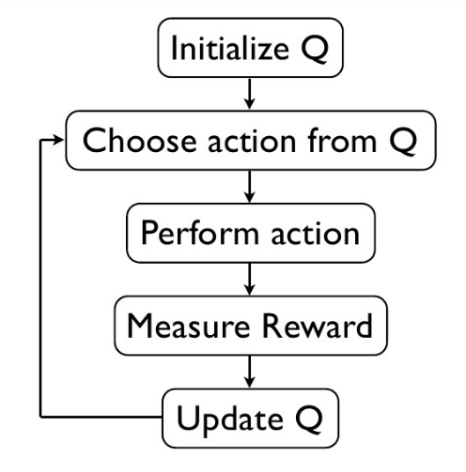

Slide 94
Algorithm
The Q-Learning algorithm goes as follows:
1. Set the gamma parameter, and environment rewards in matrix R.
2. Initialize matrix Q to zero
3. For each episode:
Select a random initial state.
Do While the goal state hasn't been reached.
Select one among all possible actions for the current state.
Using this possible action, consider going to the next state.
Get maximum Q value for this next state based on all possible actions.
Compute: Q(state, action) = R(state, action) + Gamma * Max[Q(next state, all actions)]
Set the next state as the current state.
End Do
End For

Slide 95
Set learning parameter Gamma = 0.8,
initial state as Room 1.
Initialize matrix Q as a zero matrix:
By random selection, select to go to 5 as action

Slide 96
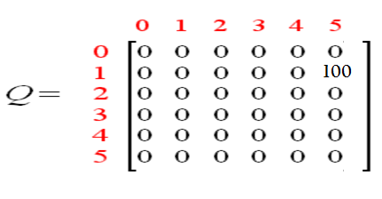
1
4
5
5
Q(state, action) = R(state, action) + Gamma * Max[Q(next state, all actions)]
Q(1, 5) = R(1, 5) + 0.8 * Max[Q(5, 1), Q(5, 4), Q(5, 5)] = 100 + 0.8 * 0 = 100
Since matrix Q is still initialized to zero, Q(5, 1), Q(5, 4), Q(5, 5), are all zero.
The next state, 5, now becomes the current state.
Because 5 is the goal state, we've finished one episode.
agent's brain now contains an updated matrix Q as:

Slide 97
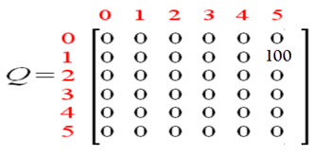
For next episode, randomly chosen initial state.
choose state 3 as initial state.
By random selection, select state 1 as action.
Q(state, action) = R(state, action) + Gamma * Max[Q(next state, all actions)]
Q(3, 1) = R(3, 1) + 0.8 * Max[Q(1, 3), Q(1, 5)]
= 0 + 0.8 * Max(0, 100) = 80
We use the updated matrix Q
from the last episode.
1
2
4
3
3
5
1

Slide 98
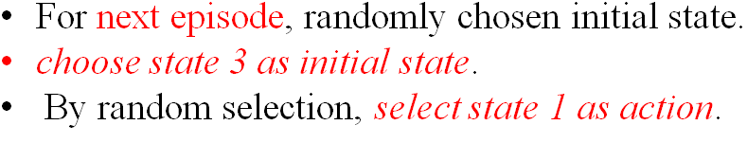
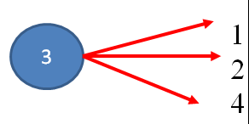
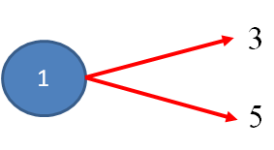
Q(state, action) = R(state, action) + Gamma * Max[Q(next state, all actions)]
Q(3, 1) = R(3, 1) + 0.8 * Max[Q(1, 3), Q(1, 5)]
= 0 + 0.8 * Max(0, 100) = 80

Slide 99
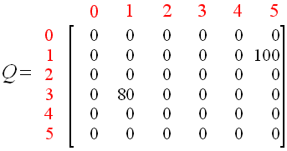
The matrix Q becomes
The next state, 1, now becomes the current state.
Repeat the inner loop of the Q learning algorithm because state 1 is not the goal state.

Slide 100
Set: current state 1
two possible actions: go to state 3, or go to state 5.
Randomly choose action state 5.

Slide 101
Q(state, action) = R(state, action) + Gamma * Max[Q(next state, all actions)]
Q(1, 5) = R(1, 5) + 0.8 * Max[Q(5, 1), Q(5, 4), Q(5, 5)] = 100 + 0.8 * 0 = 100
1
4
5
5
Reached to goal state finish this episode.
agent's brain now contain updated matrix Q as:

Slide 102
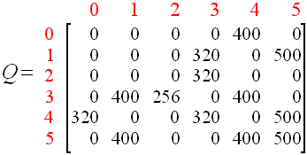
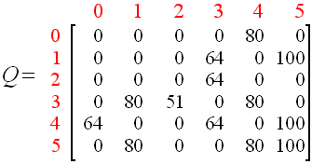
agent learns more through further episodes
finally reach convergence values in matrix Q like:
This matrix Q, can then be normalized (i.e.; converted to percentage) by dividing all non-zero entries by 5 :

Slide 103
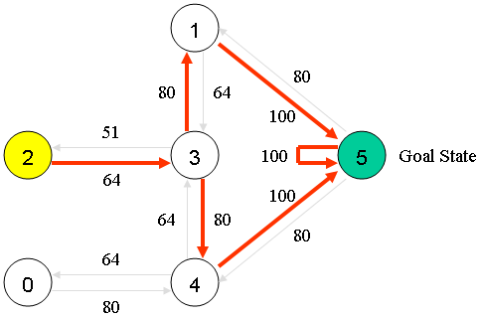
Agent has learned the most optimal paths to the goal state through experience.
Best sequences : the links with the highest values at each state.
Thus the sequence is 2 - 3 - 1 – 5 or 2-3-4-5

Slide 104
Other variants of Q learning

Slide 105
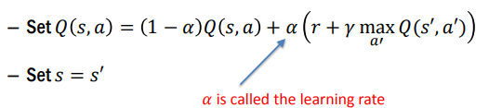
Q(state, action)
= Q(state, action) + α [ R(state, action) +
γ * Max(Q(next state, all actions) )- Q(state, action) ]
α (learning rate) When alpha is close to 0, we’re not updating very aggressively. When alpha is close to 1, we’re simply replacing the old value with the updated value.
γ(discount factor) This quantifies the difference in importance between immediate rewards and future rewards.

Slide 106
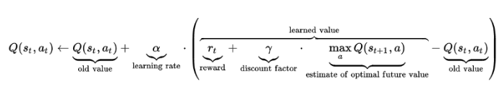

Slide 107
Q(state, action)
= Q(state, action) + α [ R(state, action) +
γ * Max(Q(next state, all actions) - Q(state, action) ]
α (learning rate) When alpha is close to 0, we’re not updating very aggressively. When alpha is close to 1, we’re simply replacing the old value with the updated value.
γ(discount factor) This quantifies the difference in importance between immediate rewards and future rewards.

Slide 108
Conclusion
Reinforcement learning addresses a very broad and relevant question:How can we learn to survive in our environment?
We have looked at Q-learning, which simply learns from experience. No model of the world is needed.
We made simplifying assumptions: e.g. state of the world only depends on last state and action. This is the Markov assumption. The model is called a Markov Decision Process (MDP).
We assumed deterministic dynamics, reward function, but the world really is stochastic.
There are many extensions to speed up learning.

Slide 109
We seek a single agent which can solve any human-level task
RL (Reinforcement Learning) defines the objective
DL(Deep learning) gives the mechanism
RL + DL = general intelligence

Slide 110
end

Slide 111
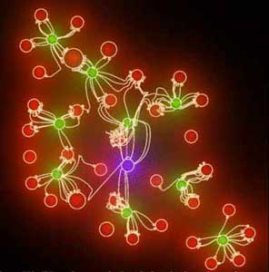
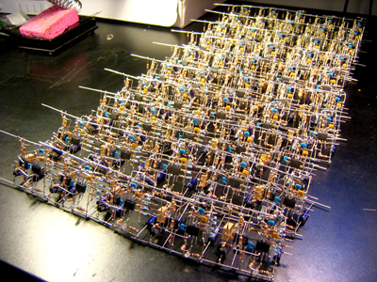
What is Neural Network?
Relatively crude electronic networks of "neurons" based on the neural structure of the brain.
Can learn by trial and error any network of neurons or nuclei that function together to perform some function in the body
NEURAL NETWORK
ARTIFICIAL NEURAL NETWORK

Slide 112
Q Learning Example
5 rooms in a building connected by doors as shown in the figure below.
The outside of the building can be thought of as one big room (5).
Doors 1 and 4 lead from building to room 5 (outside).

Slide 113
Cont..
=>
Each room ≡ node
Each door ≡ link.
Goal room number =5
Room 5 loops back to itself .

Slide 114
Cont..
Each arrow contains an instant reward value, as shown below:
associate a reward value to each door (i.e. link between nodes
The doors that lead immediately to the goal have an instant reward of 100
Otherwise reward = 0
In Q-learning, the goal is to reach the state with the highest reward, so that if the agent arrives at the goal, it will remain there forever. This type of goal is called an "absorbing goal".

Slide 115
Cont.
Imagine our agent as a dumb virtual robot that can learn through experience.
The agent can pass from one room to another but has no knowledge of the environment, and doesn't know which sequence of doors lead to the outside.
Now suppose we have an agent in Room 2 and we want the agent to learn to reach outside the house (5).

Slide 116
Cont..
We'll call each room, including outside (room no 5), a "state“
The agent's movement from one room to another will be an "action"
In our diagram, a "state" is depicted as a node, while "action" is represented by the arrows.

Slide 117
Reward Table, "matrix R".
-1 : No link between nodes
0 : reward is zero
100 : reward is 100 if reaching to goal state

Slide 118
Matrix "Q"
Matrix, "Q“ : representing the memory of agent what the agent has learned through experience.
Rows : current state of the agent
Columns : possible actions leading to the next state (the links between the nodes).
matrix Q is initialized to zero as:

Slide 119
What We Have Till Now??
Reward Matrix (R)
Q Matrix (Q)

Slide 120
Formula
Q(state, action) = R(state, action) +
Gamma * Max[Q(next state, all actions)
According to this formula, a value assigned to a specific element of matrix Q, is equal to the sum of the corresponding value in matrix R and the learning parameter Gamma, multiplied by the maximum value of Q for all possible actions in the next state.
The agent will explore from state to state until it reaches the goal. We'll call each exploration an episode
Each time the agent arrives at the goal state, the program goes to the next episode

Slide 121
Gamma
Range :(0 <= Gamma > 1)
closer to zero => the agent will tend to consider only immediate rewards
closer to one => the agent will consider future rewards with greater weight, willing to delay the reward
Algorithm to utilize the Q matrix:
1. Set current state = initial state.
2. From current state, find the action with the highest Q value.
3. Set current state = next state.
4. Repeat Steps 2 and 3 until current state = goal state.
The algorithm above will return the sequence of states from the initial state to the goal state.

Slide 122
Algorithm
The Q-Learning algorithm goes as follows:
1. Set the gamma parameter, and environment rewards in matrix R.
2. Initialize matrix Q to zero
3. For each episode:
Select a random initial state.
Do While the goal state hasn't been reached.
Select one among all possible actions for the current state.
Using this possible action, consider going to the next state.
Get maximum Q value for this next state based on all possible actions.
Compute: Q(state, action) = R(state, action) + Gamma * Max[Q(next state, all actions)]
Set the next state as the current state.
End Do
End For

Slide 123
Cont..
Set learning parameter Gamma = 0.8,
initial state as Room 1.
Initialize matrix Q as a zero matrix:
By random selection, select to go to 5 as action

Slide 124
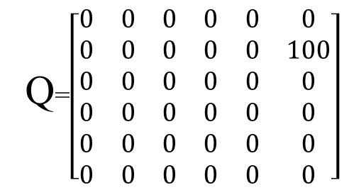
Cont..
1
4
5
5
Q(state, action) = R(state, action) + Gamma * Max[Q(next state, all actions)]
Q(1, 5) = R(1, 5) + 0.8 * Max[Q(5, 1), Q(5, 4), Q(5, 5)] = 100 + 0.8 * 0 = 100
Since matrix Q is still initialized to zero, Q(5, 1), Q(5, 4), Q(5, 5), are all zero.
The next state, 5, now becomes the current state.
Because 5 is the goal state, we've finished one episode.
agent's brain now contains an updated matrix Q as:
Q=$\left[\begin{matrix}0 & 0 & 0 & 0 & 0 & 0 \\ 0 & 0 & 0 & 0 & 0 & 100 \\ 0 & 0 & 0 & 0 & 0 & 0 \\ 0 & 0 & 0 & 0 & 0 & 0 \\ 0 & 0 & 0 & 0 & 0 & 0 \\ 0 & 0 & 0 & 0 & 0 & 0\end{matrix}\right]$

Slide 125
Cont..
For next episode, randomly chosen initial state.
choose state 3 as initial state.
By random selection, select state 1 as action.
Q(state, action) = R(state, action) + Gamma * Max[Q(next state, all actions)]
Q(3, 1) = R(3, 1) + 0.8 * Max[Q(1, 3), Q(1, 5)] = 0 + 0.8 * Max(0, 100) = 80
We use the updated matrix Q from the last episode.
3
1
2
4
3
5
1

Slide 126
Cont..
The matrix Q becomes
The next state, 1, now becomes the current state.
Repeat the inner loop of the Q learning algorithm because state 1 is not the goal state.

Slide 127
Cont..
Set: current state 1
two possible actions: go to state 3, or go to state 5.
Randomly choose action state 5.

Slide 128
Cont..
Q(state, action) = R(state, action) + Gamma * Max[Q(next state, all actions)]
Q(1, 5) = R(1, 5) + 0.8 * Max[Q(5, 1), Q(5, 4), Q(5, 5)] = 100 + 0.8 * 0 = 100
5
1
4
5
Reached to goal state
finish this episode.
agent's brain now contain updated matrix Q as:

Slide 129
Cont..
If agent learns more through further episodes
finally reach convergence values in matrix Q like:
This matrix Q, can then be normalized (i.e.; converted to percentage) by dividing all non-zero entries by 5 :

Slide 130
Cont..
Agent has learned the most optimal paths to the goal state through experience.
Best sequences : the links with the highest values at each state.
Thus the sequence is 2 - 3 - 1 - 5.

Slide 131
Matlab Commands
Clc ;
format short
format compact
% two input: R and gamma;
% immediate reward matrix;
% row and column=states;
% -1=no door between room
R=[-1,-1,-1,-1,0,-1;
-1,-1,-1,0,-1,100;
-1,-1,-1,0,-1,-1;
-1,0,0,-1,0,-1;
0,-1,-1,0,-1,100;
-1,0,-1,-1,0,100];
Notes:
Compact: Suppresses excess line feeds to show more output in a single screen.
short Scaled fixed point format, with 5 digits eg:3.1416

Slide 132
Cont..
gamma=0.80; %learning parameter
goalstate = 5;
Q=zeros(size(R)); %initialize Q as zero matrix
Q1=ones (size(R))*(-1) % initialize previous Q as negative number
Count=0; %counter
for episode =1:50000 % random initial state
Y=randperm(size (R,1)); % returns an matrix with random values
State =y(1);

Slide 133
Cont..
While state ~=goal state , %loop until reach
goal state % select any action from this state
x=find(R(state,:)>=0); %find possible action of this state
If size(x,1)>0,
x1=randompermutation(x); %randomize the possible action
x1=x1(1); %select an action
end
Qmax=max(q,[ ],2);
Q(state ,x1)=R(state ,x1)+gamma*Qmax(x1);
%get max of all actions
State =x1;
end

Slide 134
Cont..
%break if convergence: small deviation on Q for 1000 consecutive
if sum (sum(abs(Q1-Q)))<0.0001 & sum(sum(q>0))
if count>1000,
episode %report last episode
break
else
Count=count+1; %set counter if deviation of Q is small
end
else
Q1=Q;
count=0; % reset counter when deviation of Q from previous Q is large
end
end

Slide 135
Cont..
%normalize Q
g=max(max(Q));
If g>0,
Q=100*q/g;
end

